Slide 1

Gertie Games
Some tagline
Available Titles

Slide 2


Slide 3
Gertie, wake up!
You’ve gotta head down to Beckley Park for your big day!

Slide 4
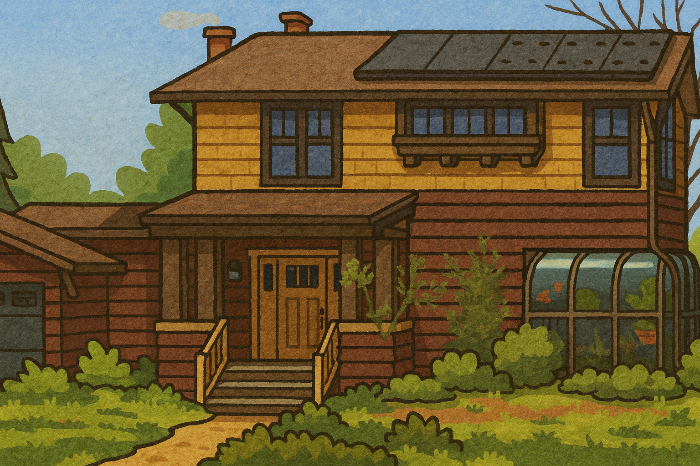
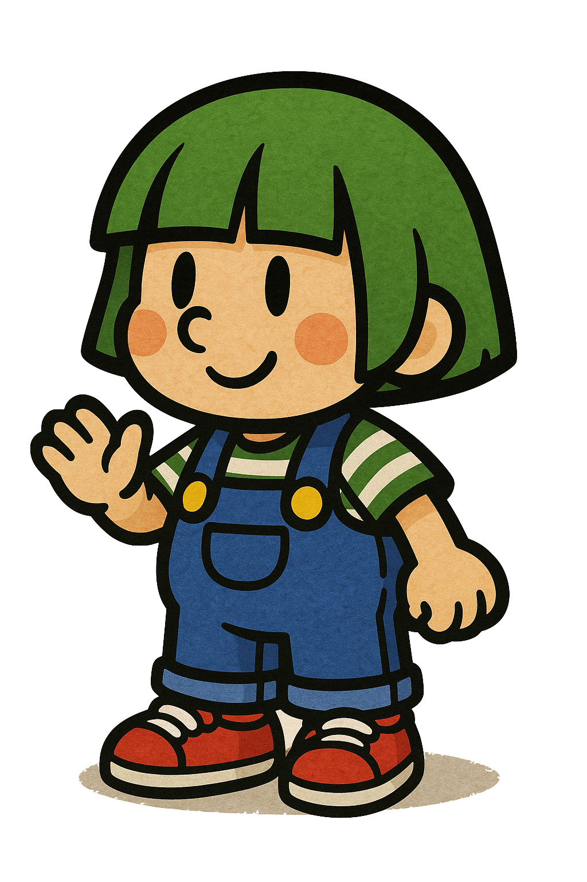


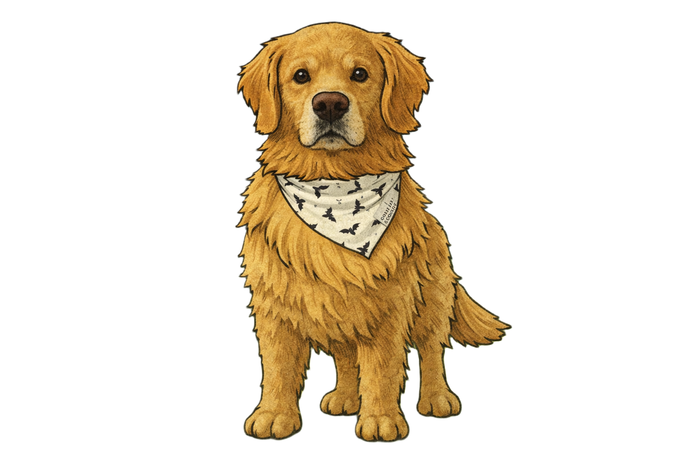

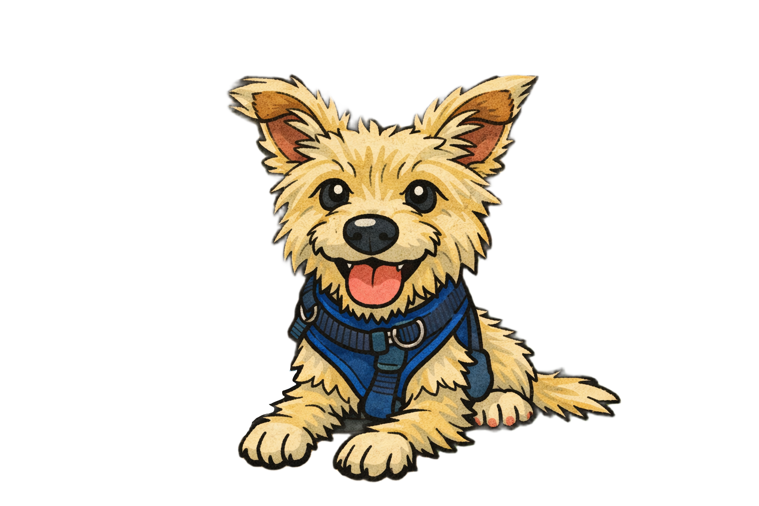
It’s Grandpa and the dogs!
“Gertie, I can’t remember how many leashes I need, can you help me count the dogs?”

Slide 5
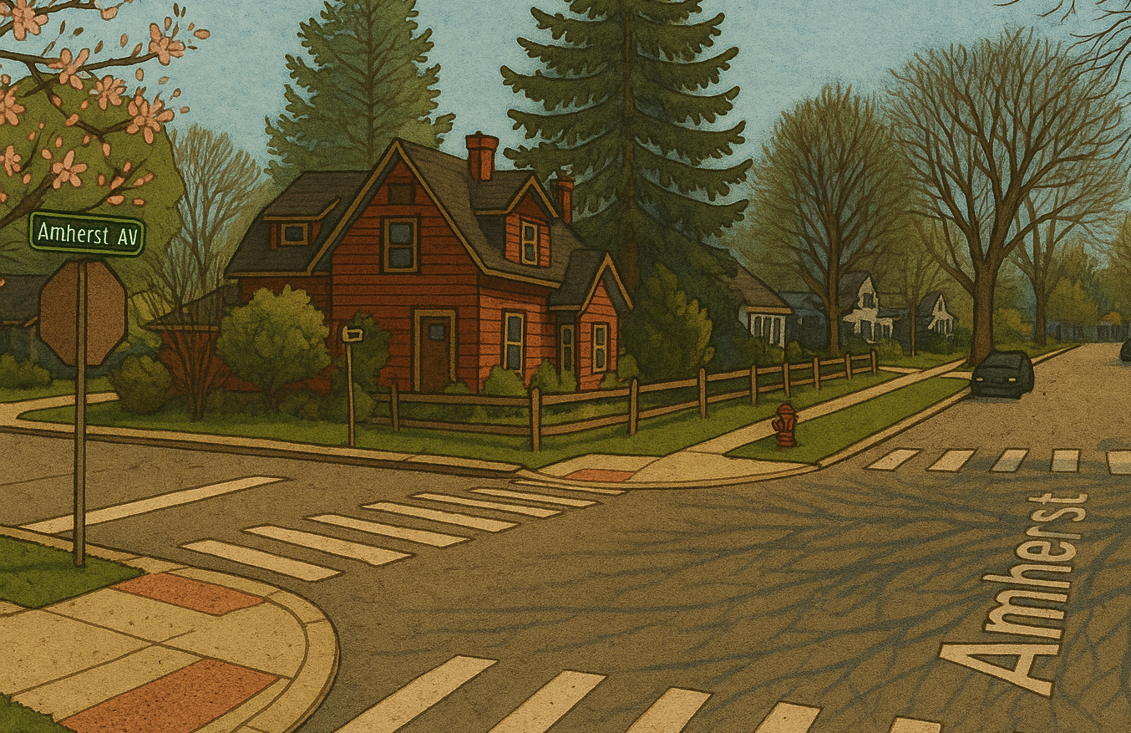
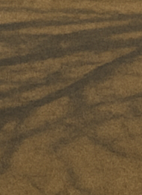
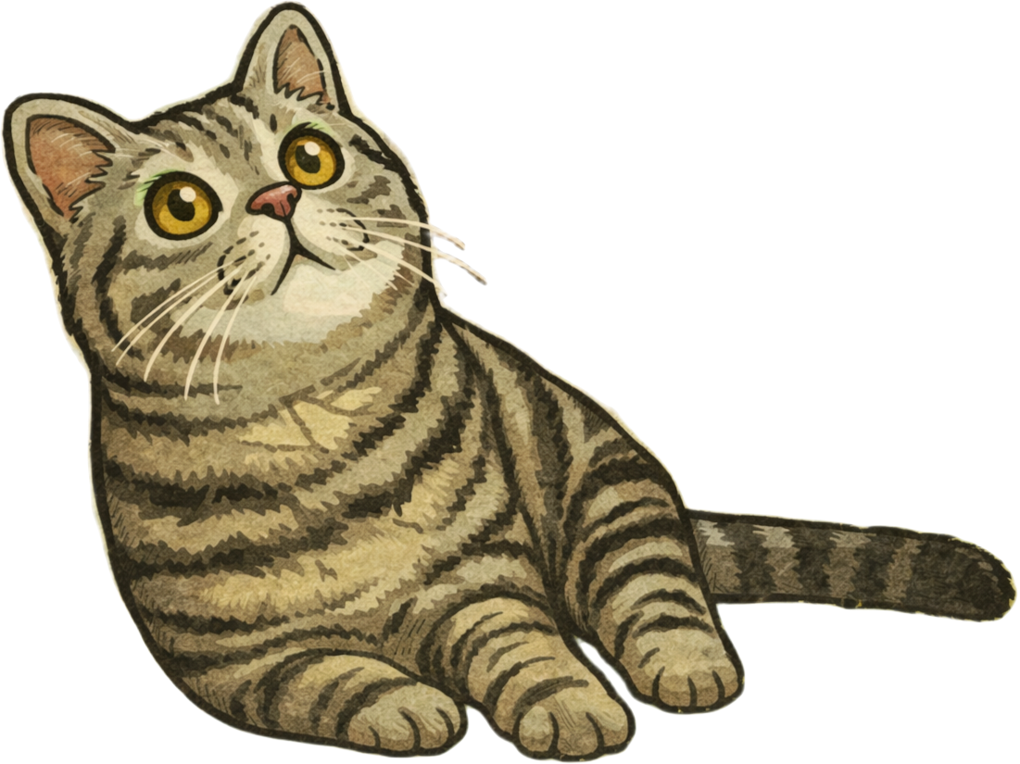
It’s Spike the cat! Let’s pet Spike

Slide 6
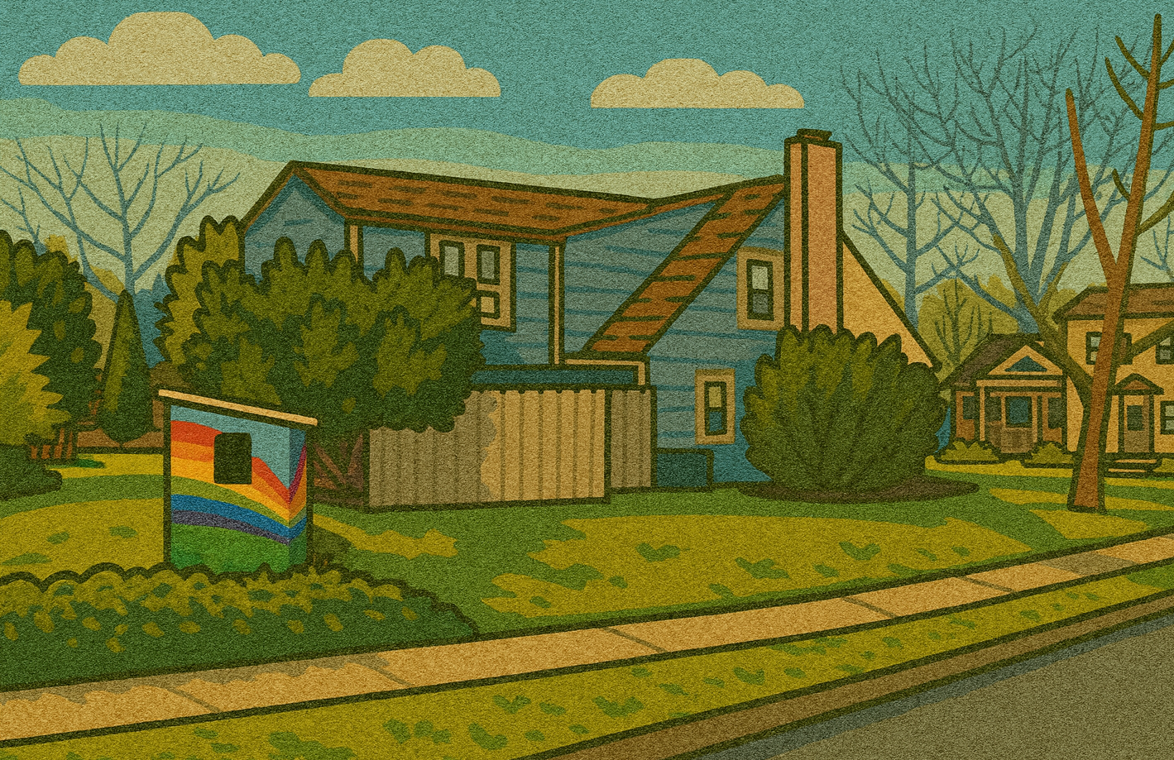


It’s the Kramer’s House! They lost an egg, can you help them find it?

Slide 7
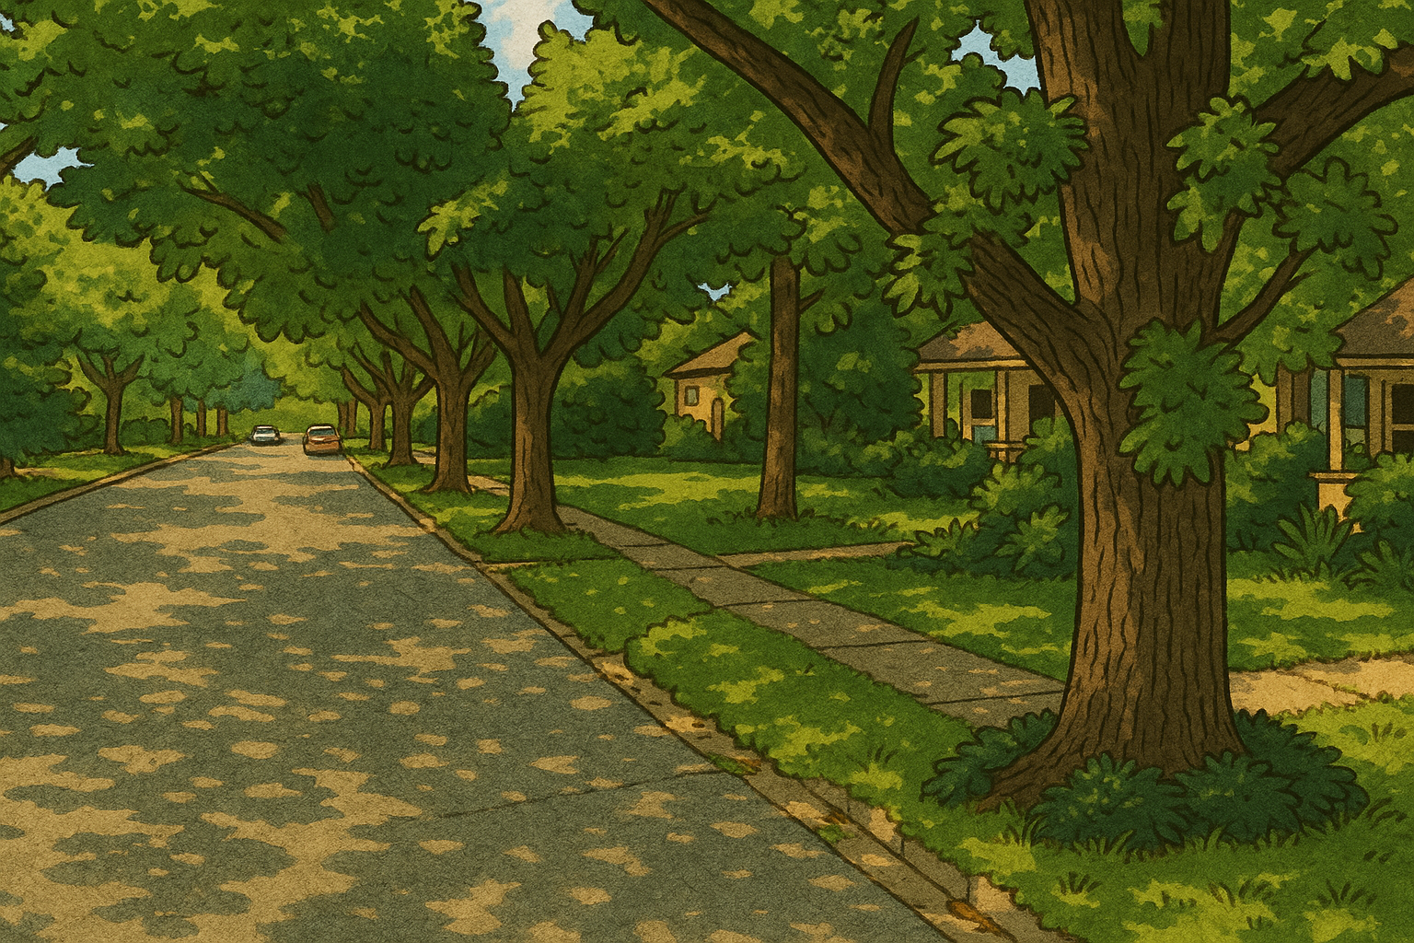
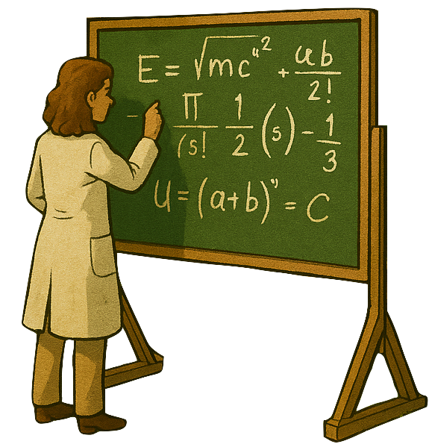

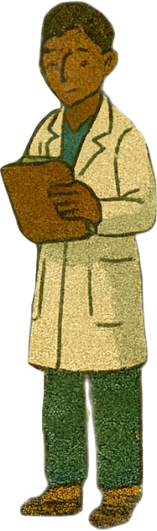




It’s Grandma! “I know that Beckley is just
down the road here Gertie,
but we’ve gotta study this cool
mushroom. Can you find
another way around?”

Slide 8
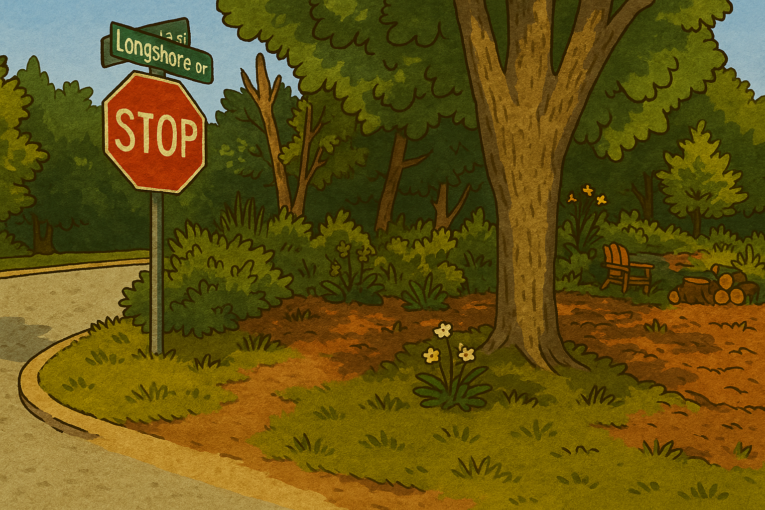



I think I see a skunk in the bushes! Let’s watch out for that

Slide 9
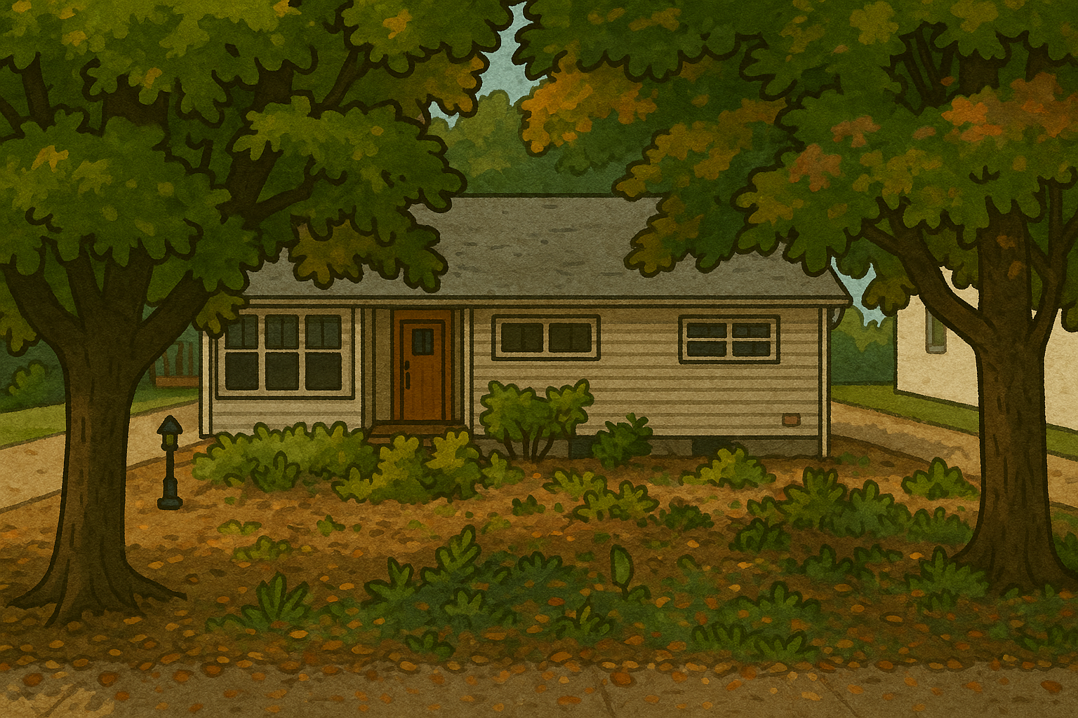

It’s Brooklyn! He must have taken himself for a walk down to his friend Hazel’s house

Slide 10
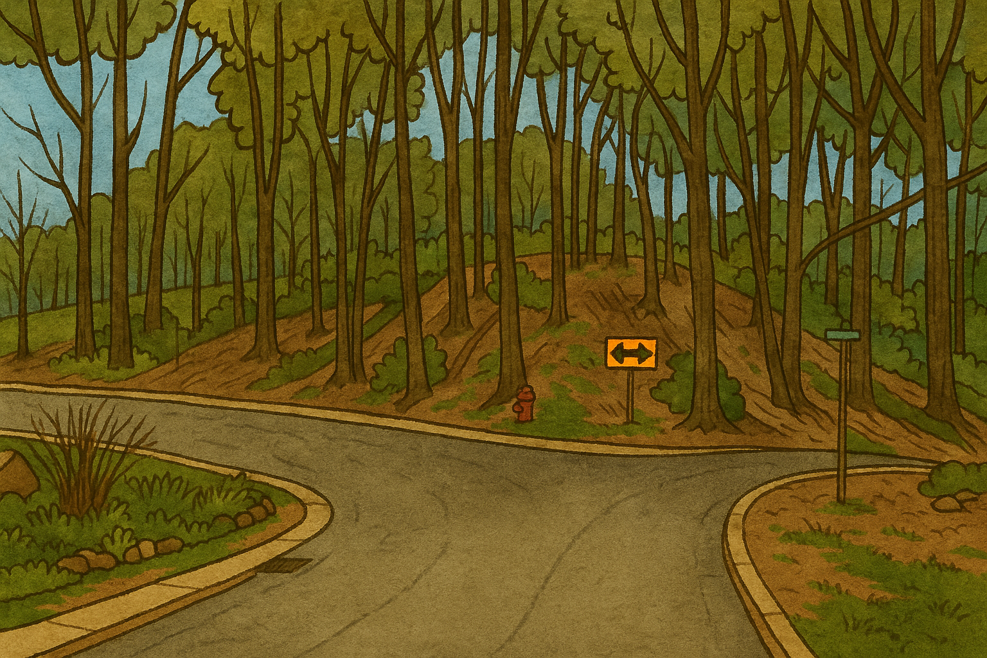

There’s a fork in the road! I think I see some balloons out to the left, though!
Party equipment

Slide 11
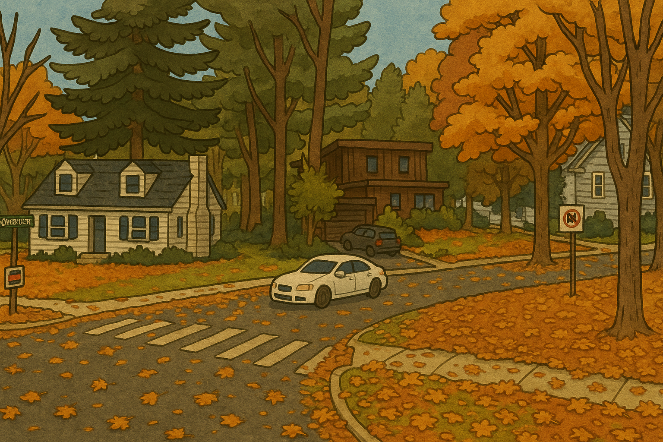


Aunt Marge is blowing up like a balloon! Oh wait, that’s just a big balloon of Aunt Marge and Uncle Tommy is carrying it down to the park!

Slide 12
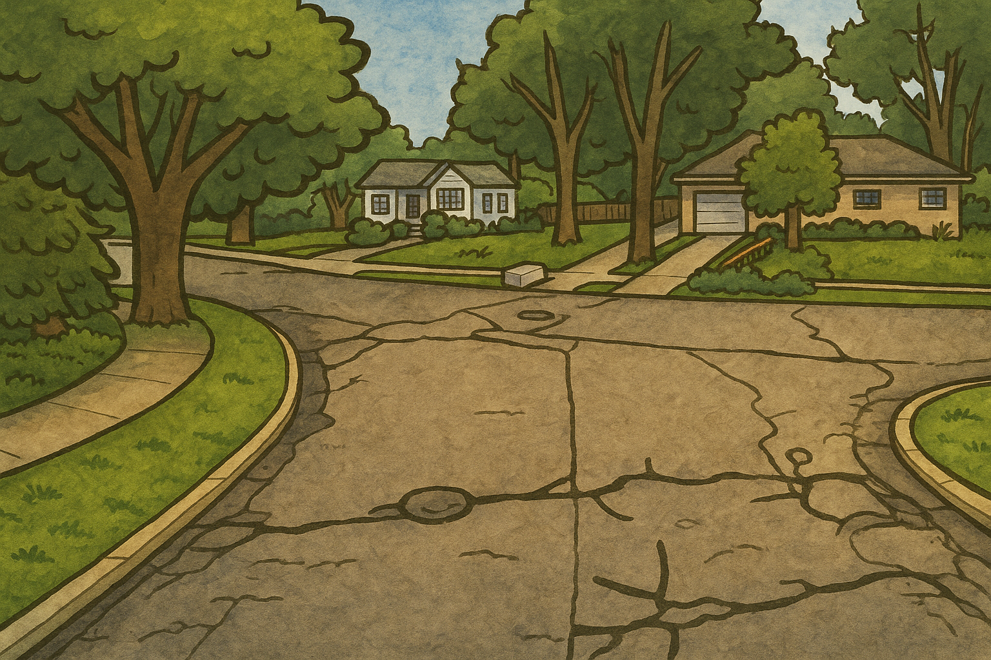
It’s Grandma and Grandpa with the dogs! I guess they’re done studying the mushroom

Slide 13
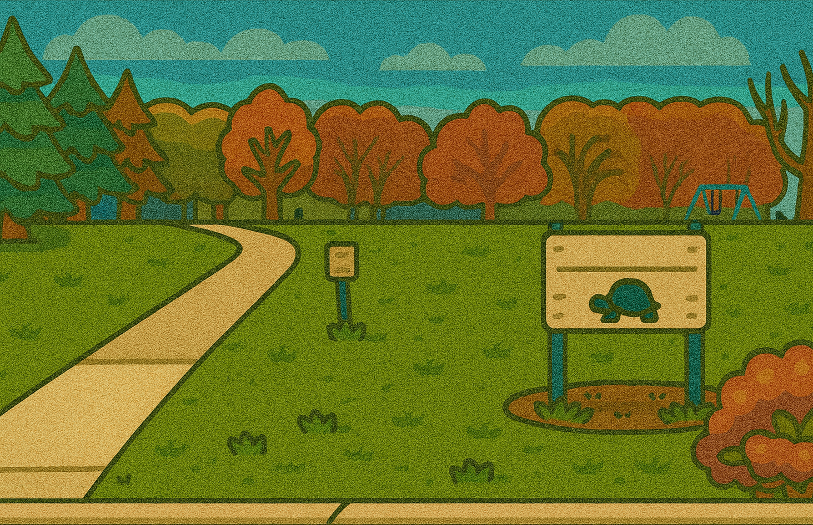



There are definitely balloons there! Let’s go!

Slide 14
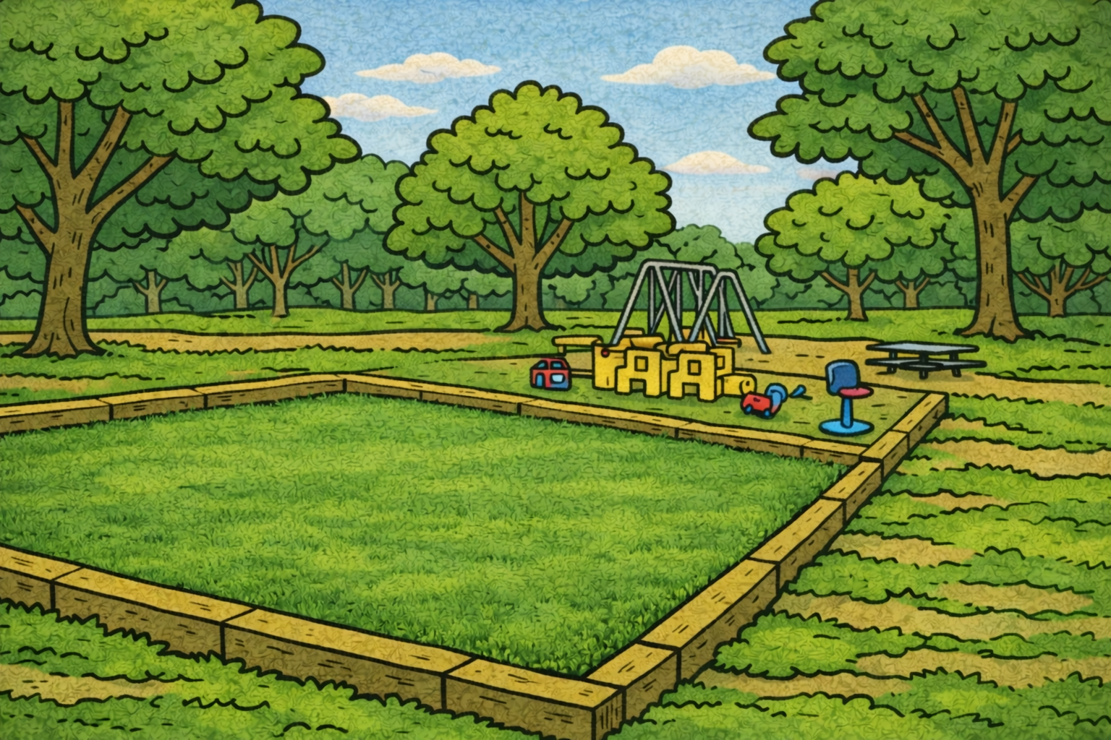
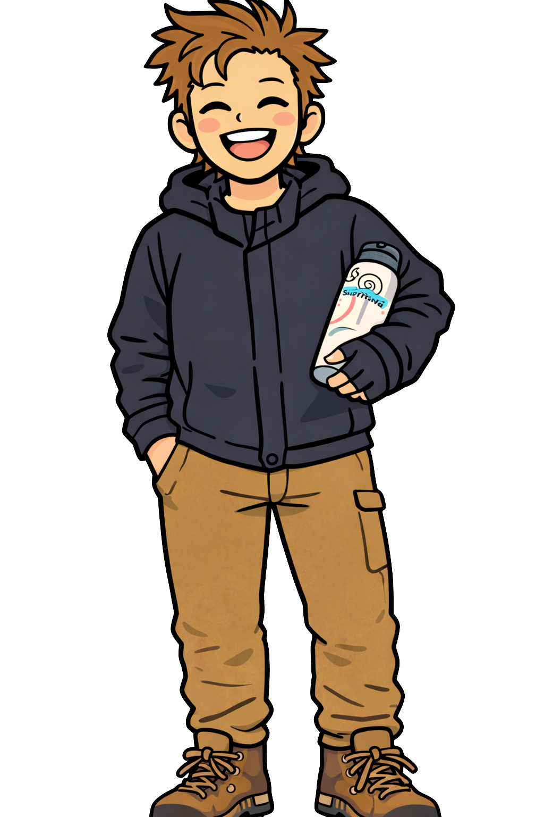
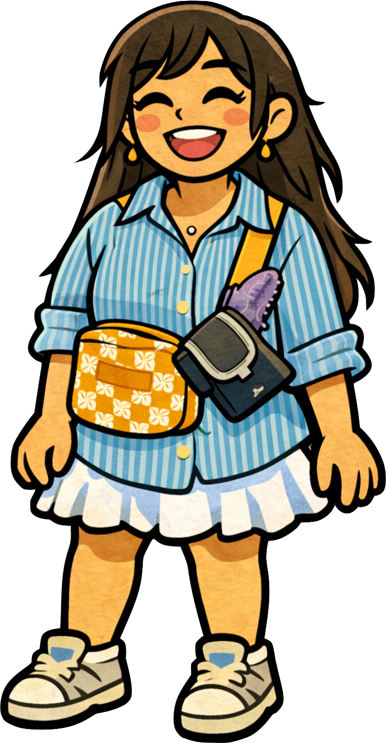
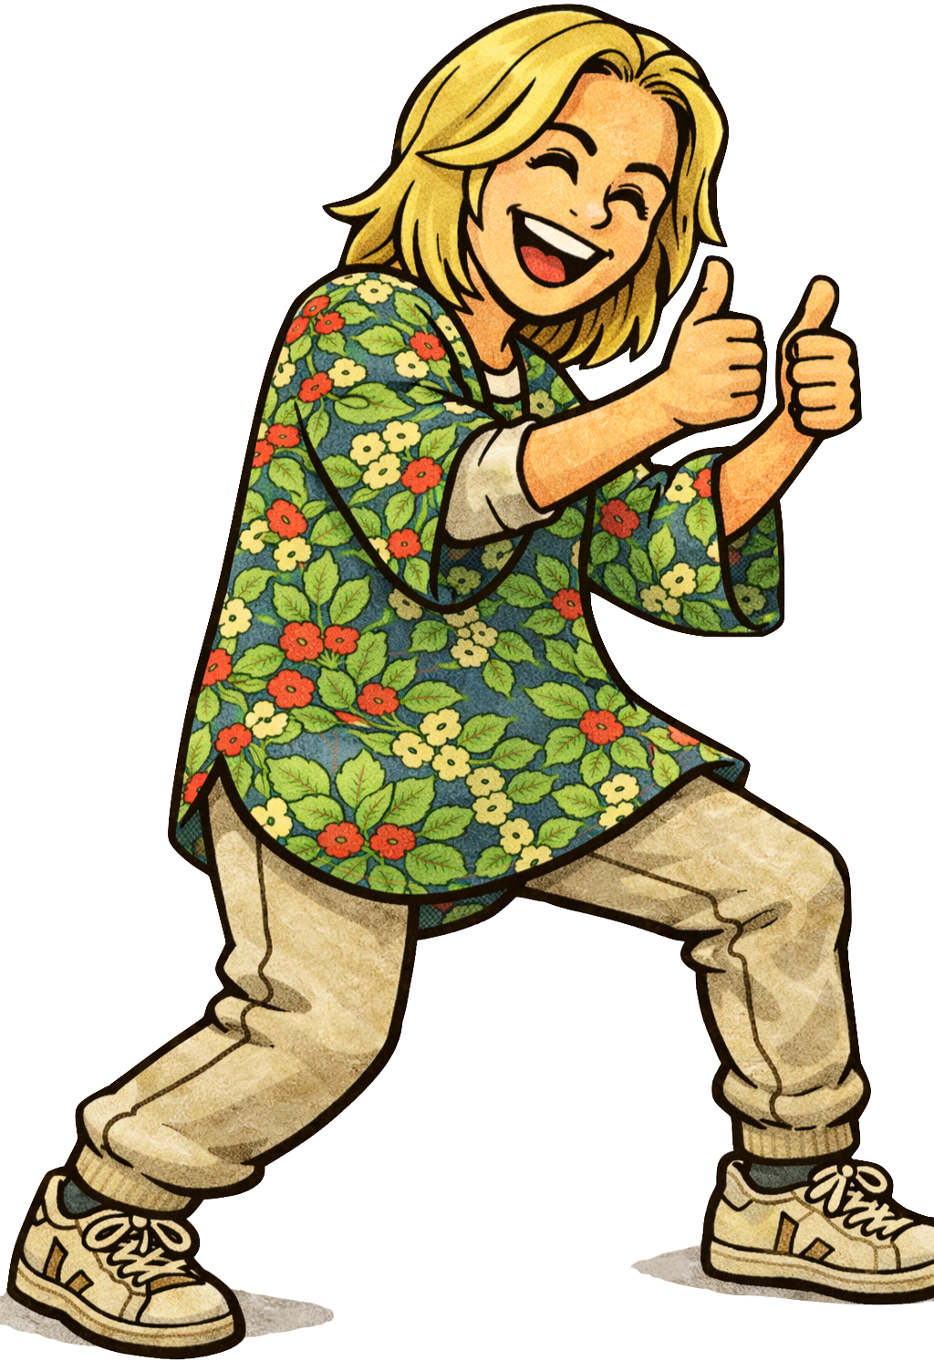



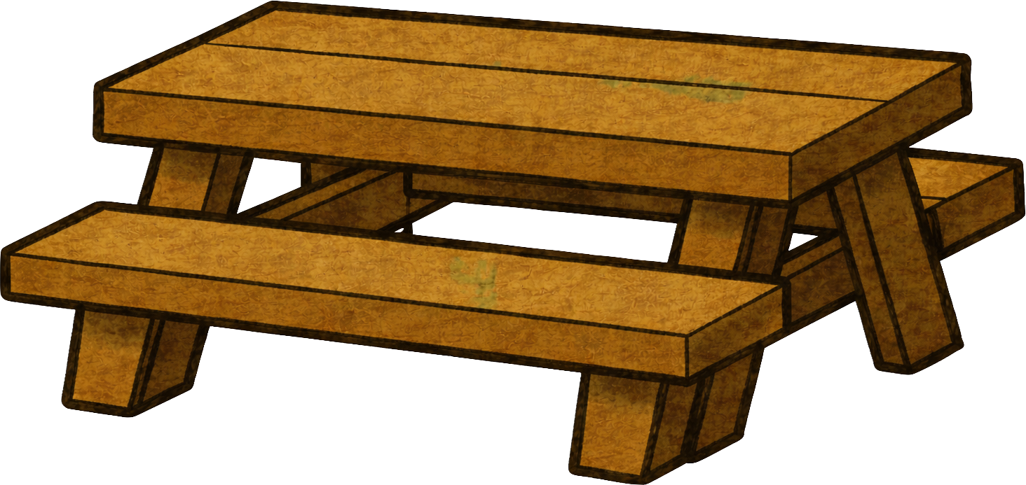
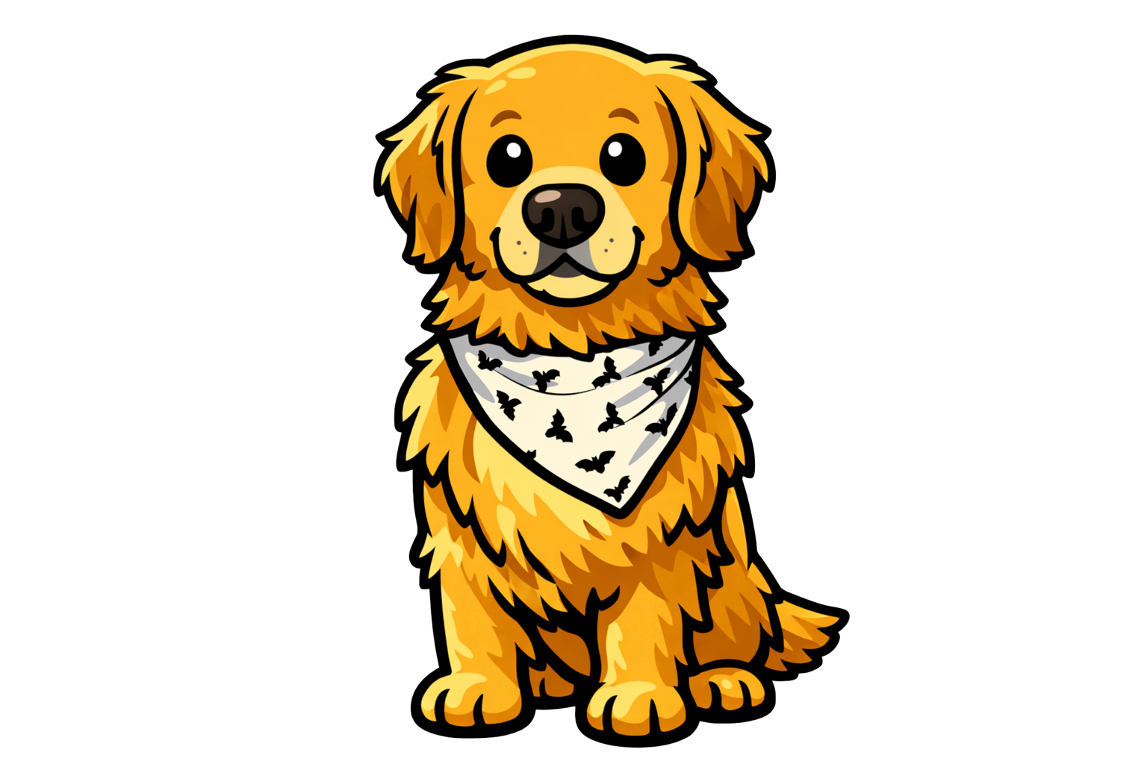
We made it and everyone is here!
Happy Birthday Gertie!

